Slide 1




BEER SALES AND DISTRIBUTION SYSTEM FOR BGI ETHIOPIA
ADAMA SCIENCE AND TECHNOLOGY UNIVERSITY
FEBRUARY – 5 - 2022

Slide 2

Contents
01. INTRODUCTION
02.
EXISTING SYSTEM
03.
PROPOSED SYSTEM
04.
SYSTEM DESIGN

Slide 3

Introduction
Ethiopia’s beer market has been steadily growing for the past decade. Beer companies have their way of distribution mechanism for the high demand from customers. Among them, BGI Ethiopia is one of the beer companies in Ethiopia that have four bottle beer products namely St. George, castle, Doppel, and Senq’ along with other products. BGI Ethiopia does not sell its products directly to end-users. Mass production, consumption, and distribution rely on agents, representatives, retailers, brokers, or some combination of these intermediaries to distribute their products.
In this project, we will try to solve the problems faced in the distribution and sales process by reducing the number of intermediaries and brokers by developing a web-based beer sales and distribution system.

Slide 4

STATEMENT OF THE PROBLEM
❖Absence of a well-integrated and comprehensive approach to product availability and distribution coverage.
❖Time delay because of the queues at the company
❖Paper-based and unorganized report generation
❖Manual payment system
❖Ineffective communication between agent and customer
❖Improper management of sales and distribution mechanisms.
❖The company doesn’t have well-integrated information-gathering methods of customers.

Slide 5
THE OBJECTIVE
THE GENERAL OBJECTIVE
Developing a beer sales and distribution system for BGI Ethiopia.
SPECIFIC OBJECTIVES
Gathering the required data about how the current system works from agents and promoters of BGI Ethiopia located at Adama district.
Understanding the current system based on the acquired data.
Selecting a way to improve the current system.
Identifying the main role player of the improved system(proposed system).
Selecting the appropriate tools.
Design a database and UI using the selected tools.
Implement, test, validate and deploy the system

Slide 6
SCOPE OF THE STUDY
Developing a web-based beer sales and distribution system for BGI Ethiopia in the national domain.
The system gives the privilege for the beer company to add and manage agents based on their agreements.
Customers and agents are able to
order products,
make online payments,
confirm that they have received the product, etc.
Although BGI exports its products to abroad countries, our system does not support distribution out of Ethiopia.

Slide 7
Feasibility study
Technical feasibility
The main technologies associated with our projects are: HTML (Structural Language), CSS (styling Language), JavaScript (Behavioral Language), Django Python, Diagram drawing tools (Diagram Drawing Software), reactjs
Initially, our system will host in a local server. However, for later implementations, it will be hosted in a paid web hosting space with sufficient bandwidth.
Operational feasibility
the project will support the existing system and create a good environment for its users.
Economic feasibility
Our proposed system needs few resources. The company will only need computers and an internet connection to install the system. Customers and distributors can use their smartphones to use the system. Hence, system users will not face economic difficulties using our system.
The only cost associated with our project is hosting cost, but BGI is capable of providing the budget. Therefore, we could say that our project is economically feasible.

Slide 8

Significance of the project
The current growing beer sales and distribution environment is becoming more complex and dynamic. Our project somehow minimizes the complexity in the following ways.
➢The company will collect valuable data on customer buying habits
➢The company can get their products faster to the customers
➢Eliminates intermediary expenses (cost) for the distribution process
➢Provide more controls over the agents
➢Direct online sale is accomplished
➢Build a strong relationship between beer company and agent
➢Eliminate the role of middle man

Slide 9

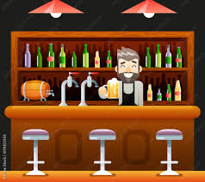


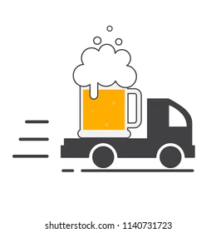
BENEFICIARIES OF THE PROJECT
➢Customers ➢BGI Ethiopia
Restaurant, grocery, cafe, hotel, shop...
➢Agents(distributors) ➢Company and agent employee

Slide 10
METHODOLOGY
Agile methodology: we’ve chosen this methodology in order to manage our project by breaking it up into several phases. This will involve constant collaboration with stakeholders(agents, customers, company promoters) and continuous improvement at every stage. Once the work begins, teams cycle through a process of planning, executing, and evaluating
Development tools
Software tools
Django python: for back-end development.
React: for front-end development
Hardware tools
Pc(laptops)
Mobile phone
Portable Huawei Router

Slide 11
Significance of the project
The current growing beer sales and distribution environment is becoming more complex and dynamic. Our project somehow minimizes the complexity in the following ways.
➢The company will collect valuable data on customer buying habits
➢The company can get their products faster to the customers
➢Eliminates intermediary expenses (cost) for the distribution process
➢Provide more controls over the agents
➢Direct online sale is accomplished
➢Build a strong relationship between beer company and agent
➢Eliminate the role of middle man

Slide 12

MAJOR FUNCTIONS OF THE EXISTING SYSTEM

Slide 13
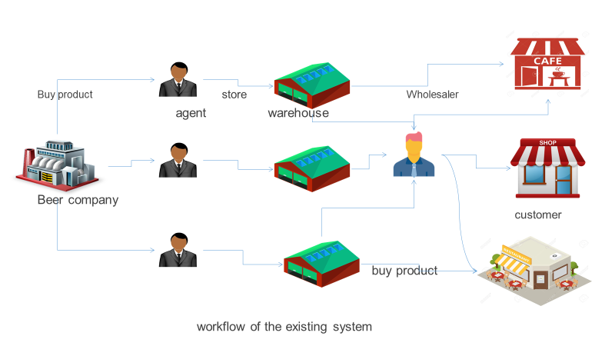
Major function of existing system

Slide 14

Users of the current system
Beer Company: Are players that are responsible for producing, selling, and distributing their beer products.
Agent: are players in the existing system that buy products from the Beer Company and sell them to wholesalers or retailers.
Sub-Agents: they work in the same way as Agents to distribute products but they get the products to form Agents, not from the company.
Sales managers: Are the type of actors that are responsible for leading and guiding a team of sales people in an organization.
Promoters: Other than other types of players, promoters are a type of actors that usually check if the product sold from Beer Company reached the final consumers.

Slide 15

Users of current system
Finance administrators: Are a type of player that is mainly responsible to administer the financial progress when sell made between the Beer Company and agent.
Wholesalers: Are players that buy products from agents and distribute the product to the retailer.
Retailers: Are players that buy products from agent and sometimes from wholesalers when the agent is not in working hours.
Drivers: these are hired by agents or sub-agents for distributing the beers with vehicles (trucks).
Laborers: are workers hired for their manual skills of loading and unloading beer crates from vehicles.
Customers (Final consumers): A final consumer is the last point in a distribution channel. include Hotels, Glossaries, Restaurants, Café, shops, Supermarkets, Companies, and more…

Slide 16

DRAWBACKS OF THE CURRENT SYSTEM
❖ The manufacturer must put out time and effort to monitor
the activities of distributors.
❖ There is always the possibility of conflicting sales efforts.
❖ Improper management of sales and distribution.
❖ Customers might not get enough information about what is been produced and how much is produced.
❖ Data collection of the distribution progress is manual and time-consuming, often causing errors and delays in reporting.
❖ Difficult data management and delays in data aggregations made actionable data analysis difficult.

Slide 17

BUSINESS RULE
Agents should have a strong agreement to buy products from the company.
❖The agreement paper of agents and the company should be
approved by the Head office of the company, which is located in Addis Ababa.
❖Agents will buy products from beer companies every day, once in
two days or once a week according to their distance from the
Company.

Slide 18
BUSINESS RULE
If the agent fails to buy the product from the Beer Company within that day, promoters will call the agent and ask them why did not they buy products and they report the reason to the staff members of the companies.
❖Customers like Hotels, Restaurants, and Groceries make a
strong agreement with agents.
❖Customers that using the company’s product are offered a lot
of materials for free like tables, chairs, draft machines,
umbrellas, towers, and more.
❖If the customers stop their business, they should return the
materials to the Beer Company or pay the amount.

Slide 19

PROPOSED SYSTEM

Slide 20
FUNCTIONAL REQUIREMENT
•Admin adds new distributors(agents).
•Customers able to register in the system through the web-application.
•Customers and agents can order products and make online payment.
•Agents and the company are able to generate report of transactions. The company schedules the agent orders

Slide 21
NON-FUNCTIONAL REQUIREMENT
Usability: Our system should be user friendly and attractive for users.
Performance: Our system should perform tasks as fast as possible,
Security: Our system should be able to provide security for all system users regarding privacy, authentication/ authorization when login and more…

Slide 22
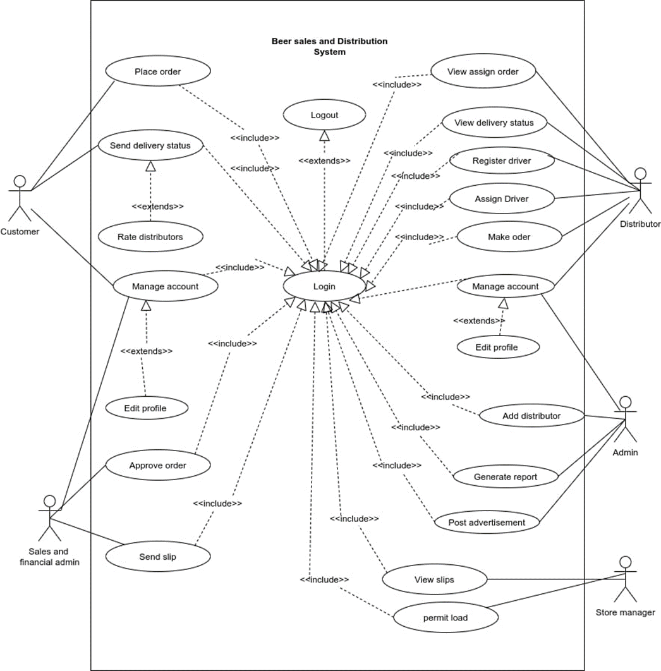

Use case model

Slide 23
SYSTEM DESIGN

Slide 24
l Proposed system architecture
OUR SYSTEM USES A THREE-TIER ARCHITECTURE.
Client-side: here in the client-side Company admin, agent admin, sales and finance admin, and customers.
Server-side: here the web servers to connect the database application are found; meaning that the application logic to perform the application by the client is found here.
Database: here the databases that store the information are found.

Slide 25
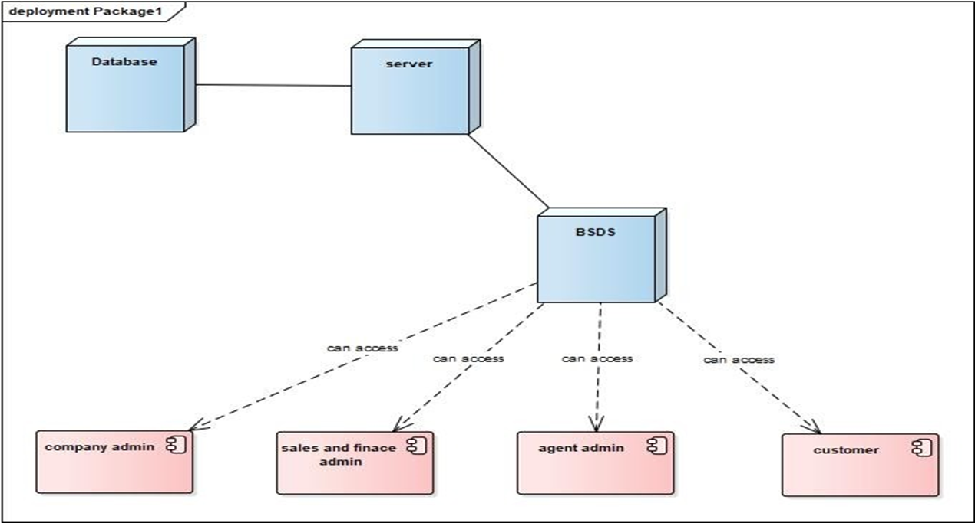
PROPOSED SYSTEM ARCHITECTURE

Slide 26
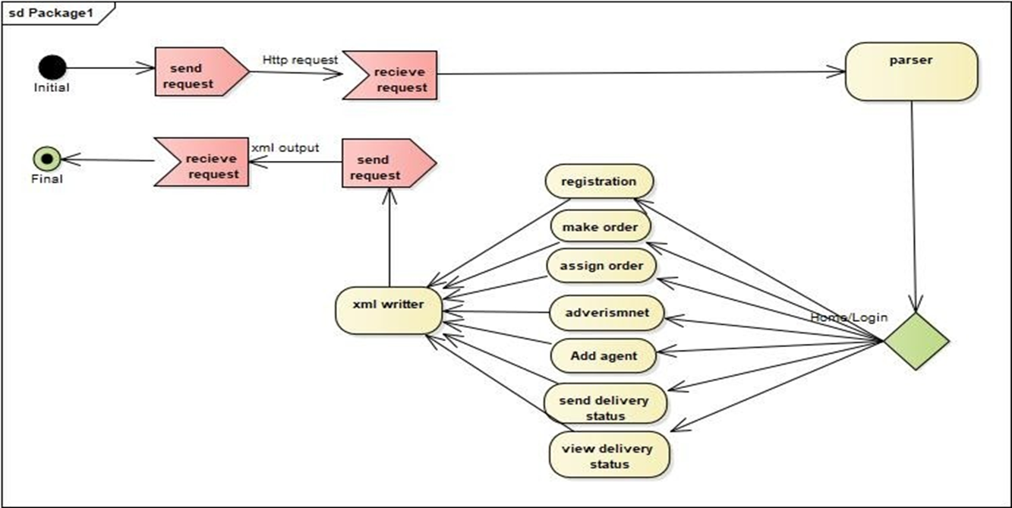
SYSTEM PROCESS

Slide 27
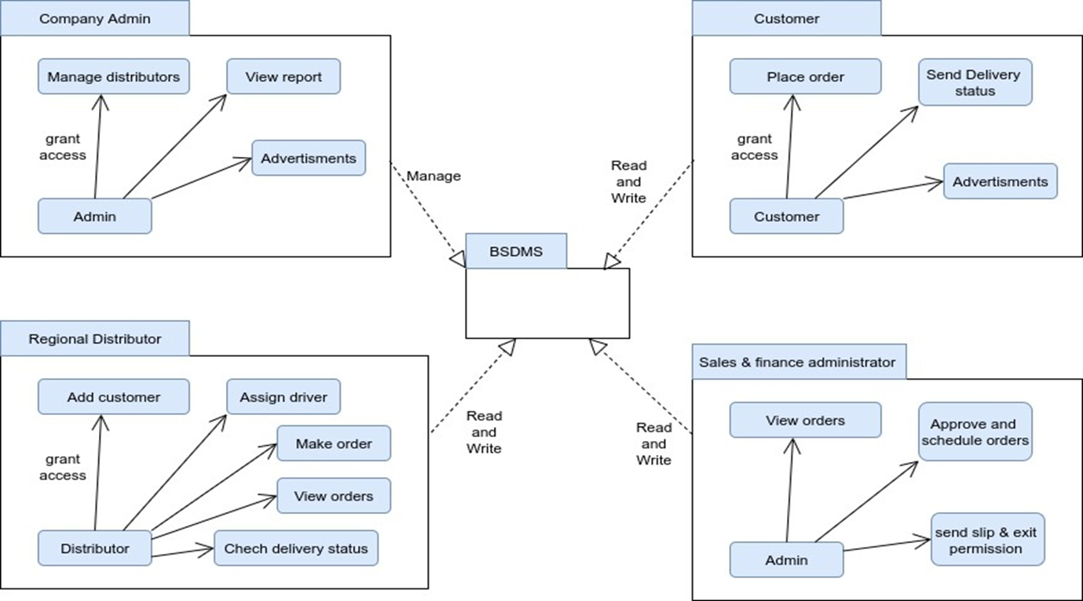
SUBSYSTEM DECOMPOSITION
Subsystems are a collection of classes, associations, operations, events, and constraints that are closely interrelated with each other.

Slide 28
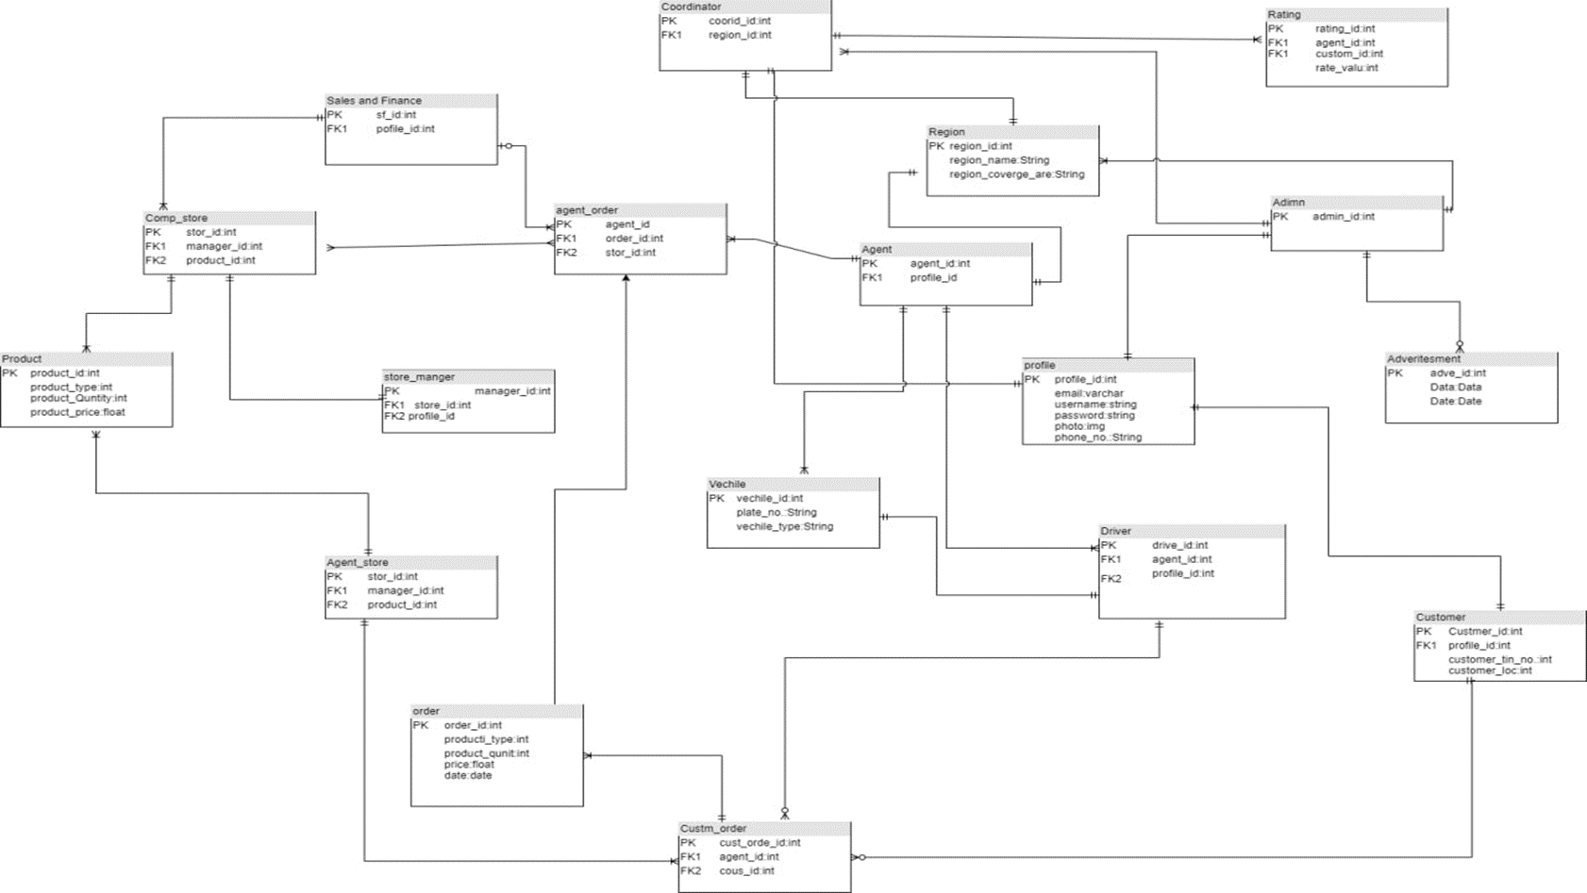
DATABASE DESIGN

Slide 29
ACCESS CONTROL
In our system, there are different actors with their respective access privileges. The following part shows actors with their privilege.
Agent Admin:- has the following privilege
Login
Logout
make an order
make payment
assign an order for the customer
View delivery status
View detailed orders
Generate report
Customer: - has the following privilege
Login
Logout
make an order
make payment
Send delivery status
Rate agent
Company Admin: -has the following privilege
Login
Logout
Register agent
Register sales and finance admin
View reports
View detailed transactions
Sales and finance Admin: -has the following privilege
Login
Logout
Approve and assign orders for the agent
Send slip and exit permission
View detail orders

Slide 30
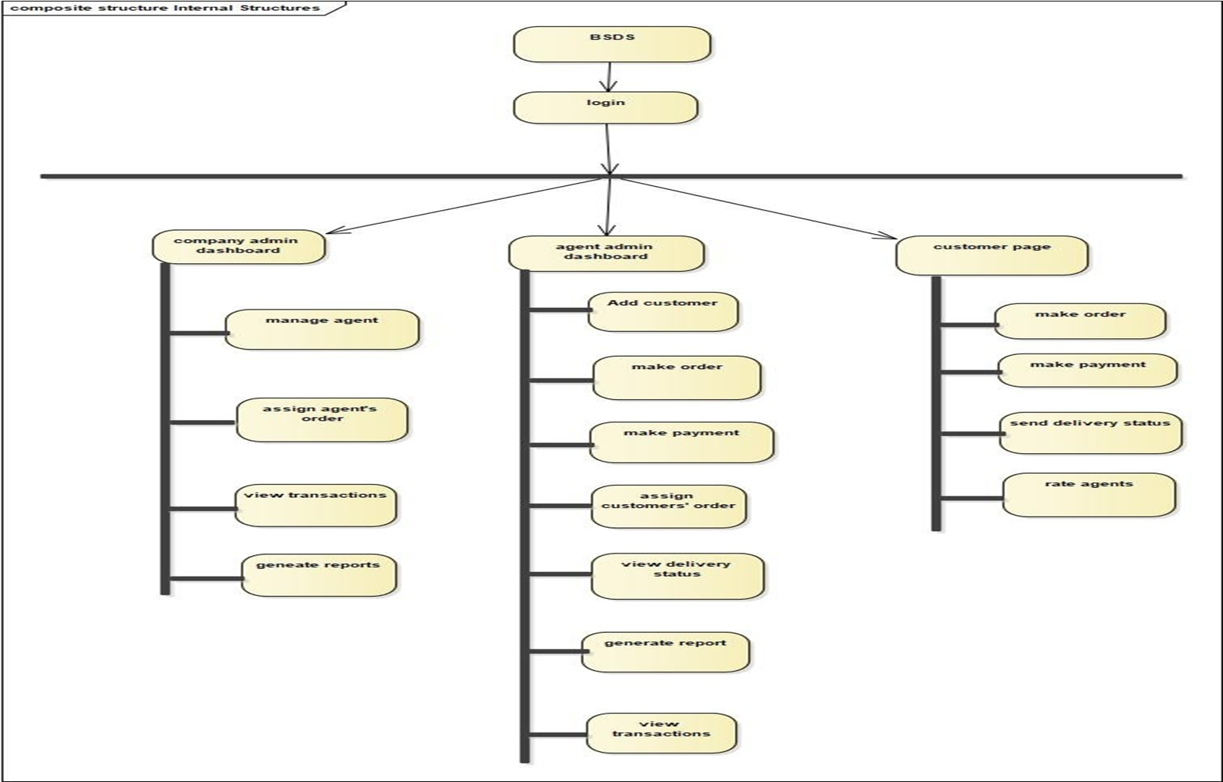
User interface design

Slide 31
l Proposed system architecture
OUR SYSTEM USES A THREE-TIER ARCHITECTURE.
Client-side: here in the client-side Company admin, agent admin, sales and finance admin, and customers.
Server-side: here the web servers to connect the database application are found; meaning that the application logic to perform the application by the client is found here.
Database: here the databases that store the information are found.

Slide 32

THANK YOU !
BEER SALES AND DISTRIBUTION SYSTEM FOR BGI ETHIOPIA
FEBRUARY – 5 - 2022

